Slide 1
Software Agile Planning and Control
This slide contains material that is copied from the book Agile Project Manager_v2_handbook by Agile Business Consortium. All rights reserved. No part of this material may be reproduced or transmitted in any form or by any means without the prior written permission of the copyright owner. This material is used here for educational purposes under the doctrine of fair use, with the intention to support learning and teaching.
For more information, please refer to the original source:
Book Title: Agile Project Manager_v2_handbook Author: Agile Business Consortium
Publisher: Buckland Media Group Limited
Year of Publication: 2017
Please consult the book for further details and complete content.

Slide 2
Outline
Introduction
DSDM Team
DSDM Products
Project Planning Concepts
Testing Concepts
Tracking and Control Concepts
Planning throughout the Life cycle
Planning and Quality
Notes:
Note of JIRA
Jira Tutorial – GeeksforGeeks
Utube JIRA
Bing Videos

Slide 3
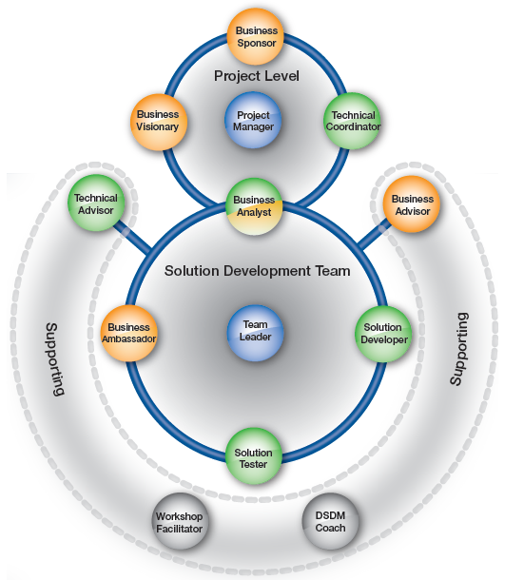
Introduction : The DSDM Team
Clear Roles & Responsibilities: DSDM assigns well-defined roles covering business, technical, management, and process interests to ensure balanced representation across the project.
Collaboration & Communication: All team members work closely together, breaking down barriers and fostering effective communication to drive project success.
Empowered, Self-Organising Teams: The best solutions come from teams that are empowered to self-organise and take responsibility within agreed boundaries.

Slide 4
DSDM Team – Role Category
Colour Scheme (Roles of Interest): Orange = Business view, Green = Solution/technical view, Blue = Management/leadership view, Grey = Process view, Mixed = Covers multiple views.
Role Categories:
    Project-level roles: Business Sponsor, Business Visionary, Technical Coordinator, Project Manager, Business Analyst → direct, manage, and govern the project.
    Solution Development Team roles: Business Ambassador, Solution Developer, Solution Tester, Business Analyst, Team Leader → engine room of the project, shaping and building the solution.
    Supporting roles: Business Advisors, Technical Advisors, Workshop Facilitator, DSDM Coach → provide guidance, expertise, and support as needed.
Role Flexibility: One person can hold multiple roles, or a role may be shared by several people, provided communication and collaboration remain effective.

Slide 5
The Roles – Business View
Business Sponsor
Senior-most project-level business role and project champion.
Owns the Business Case and project budget, ensuring continued justification.
Must hold authority to resolve business issues and make financial decisions.
Business Visionary
Provides a single clear vision for the project, avoiding confusion and misdirection.
Interprets the needs of the Business Sponsor and communicates them to the team.
Guides strategic direction, ensuring the solution delivers the expected business benefits.
Business Ambassador
Key representative of the business within the Solution Development Team.
Provides detailed input on requirements and prioritisation during Foundations and development.
Acts as the main business decision-maker, ensuring the evolving solution is fit for purpose.
Business Advisor
Specialist or subject matter expert who supports solution development or testing.
Often peers with the Business Ambassador, providing expert input when needed.
May be end users, beneficiaries, or specialists (e.g., legal/regulatory advisors).

Slide 6
The Roles – Management/leadership View
Project Manager
Provides high-level Agile-style leadership and manages the project environment.
Coordinates business and technical delivery but leaves detailed planning to the team.
Adopts a facilitative style, ensuring empowerment rather than command-and-control.
Responsible for project delivery across all phases (Foundations → Deployment).
Team Leader
Acts as a servant-leader for the Solution Development Team, ensuring collaboration and objectives are met.
Plans and coordinates detailed product delivery with the team.
Typically elected by peers as the best person to lead during a project stage.
Often combines this role with another Solution Development Team role (e.g., Business Analyst, Developer, Tester).

Slide 7
The Roles – Solution/technical view
Technical Coordinator
Acts as the project’s technical authority, ensuring technical coherence and standards.
Provides guidance on technical decisions and innovation.
Equivalent to the Business Visionary, but from a technical perspective.
Business Analyst
Bridges business and technical roles, ensuring accurate day-to-day solution decisions.
Makes sure business needs are understood and represented by the team.
Facilitates communication between business users and the development team.
Solution Developer
Interprets business requirements and builds solution increments.
Ensures functional and non-functional needs of the business are met.
Technical Advisor
Provides specialist technical expertise and input as needed.
Often represents operational perspectives like change management, support, and maintenance.
Ensures solutions are practical and sustainable for ongoing operations.
Solution Tester
Fully integrated into the team to perform continuous testing.
Validates the solution against agreed strategy throughout development.
Ensures quality and business fitness of the evolving solution.

Slide 8
The Roles – Process view, Mixed
Workshop Facilitator
Plans, organises, and facilitates workshops to achieve objectives quickly.
Ensures effective collaboration within a compressed timeframe.
Ideally independent of the workshop’s outcome.
DSDM Coach
Supports teams with limited DSDM experience.
Helps members maximise benefits of the approach within organisational context and constraints.
Guides adoption of DSDM practices effectively.

Slide 9
DSDM Team – Summary
DSDM classifies roles in two dimensions: categories and interests
Role Categories: Project-level roles, Solution Development Team roles and Supporting roles
Four Areas of Interest: Business interest, Solution / Technical interest, Management interest, and Process interest
The Business Analyst role is special: it spans both business and technical interests, acting as a bridge between project level and solution team.

Slide 10
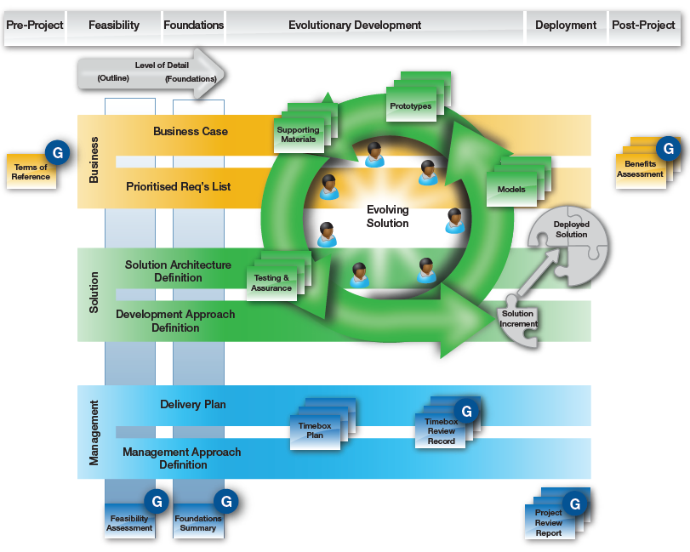
The DSDM Products
DSDM Products are the project deliverables
There are 4 categories of DSDM Products:-
Business-focused products (Orange):
    Capture and justify the business needs, priorities, and expected benefits.
Solution-focused products (Green):
Define, build, and validate the evolving solution and its supporting artefacts.
Management/control products (Blue):
Provide planning, monitoring, and governance to ensure controlled delivery.
Governance Products (marked "G"):
Key checkpoints used for approvals, compliance, and demonstrating alignment with organisational standards.
Click here for all example of template.
Notes:
dsdm-project-management-standards/README.md at master · garethjmsaunders/dsdm-project-management-standards · GitHub
User Story
Business-focused products (Orange):
Business Case: Defines justification and ongoing validity of the project.
Prioritised Requirements List: Maintains evolving business needs, ordered by priority.
Supporting Materials: Documents and inputs supporting requirements and design.
Benefits Assessment: Evaluates whether expected business benefits have been achieved.
Solution-focused products (Green):
Solution Architecture Definition: Outlines high-level structure and design of the solution.
Development Approach Definition: Defines how the solution will be built and evolved.
Evolving Solution: The core deliverable, refined through iterations.
Prototypes / Models / Testing & Assurance: Artefacts supporting solution exploration and validation.
Solution Increment / Deployed Solution: Completed parts delivered into use.
Management/control products (Blue):
Delivery Plan: High-level schedule for delivering the solution.
Management Approach Definition: Describes governance, monitoring, and reporting.
Timebox Plan & Review Records: Short-cycle plans and progress records.
Feasibility Assessment / Foundations Summary: Early justification and baseline understanding.
Project Review Report: Captures performance and lessons learned.
Governance Products (marked "G"):
Used for approval gateways, compliance, and demonstrating alignment with corporate/regulatory standards.

Slide 11
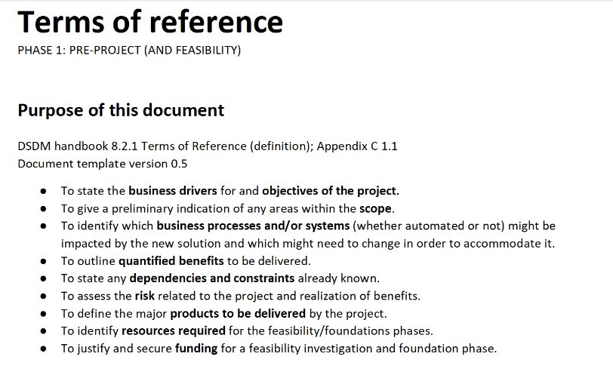
DSDM Products – Term of Reference
Overview
High-level definition of the overarching business driver and top-level objectives of the project.
Primary purpose: to scope and justify the Feasibility phase.
Acts as a governance product since it may be used for portfolio-level prioritisation and approval.
A document summarising the project’s business justification, objectives, scope, constraints, stakeholders, and alignment with organisational strategy.
Example of Terms of Reference product
Click here:
1.1 Pre-project - Terms of reference (PROJECT_CODE).docx

Slide 12
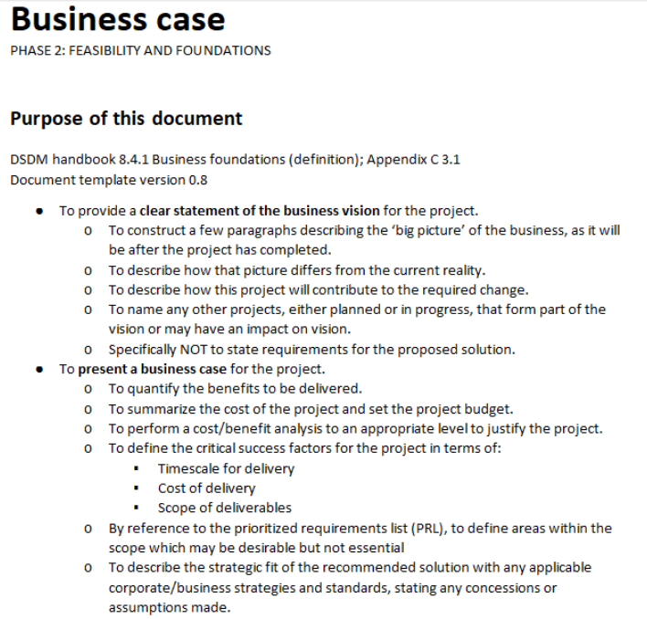
DSDM Products – Business Case
Overview
The Business Case provides a vision and a justification for the project from a business perspective.
The business vision describes a changed business as it is expected to be, incrementally and at the end of the project.
The justification for the project is typically based on an investment appraisal determining whether the value of the solution to be delivered by the project warrants the cost to produce, support and maintain it into the future, all within an acceptable level of risk.
Baselines of the Business Case are typically created first as an outline by the end of Feasibility, then as a basis for approval of development by the end of Foundations.
It is formally reviewed at the end of each Project Increment in order to determine whether further work is justified.
Example of Business Case product
Click here:
3.1 Foundations - Business case (PROJECT_CODE).docx

Slide 13
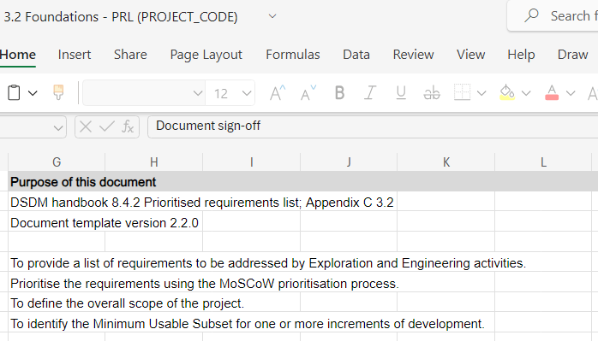
DSDM Products – Prioritised Requirements List
Overview
The PRL outlines, at a high level, the requirements the project must address.
It shows the priority of each requirement in meeting project objectives and business needs.
Consideration of requirements starts in Feasibility.
A baseline PRL, created by the end of Foundations, defines the project scope.
After Foundations, changes naturally occur in depth (detail) as the project progresses.
Changes in breadth (adding, removing, or significantly altering high-level requirements) must be formally controlled.
Control is necessary to ensure alignment with the business vision and to maintain scope discipline.
Example of PRL product
Click here:
3.2 Foundations - PRL (PROJECT_CODE).xlsx

Slide 14
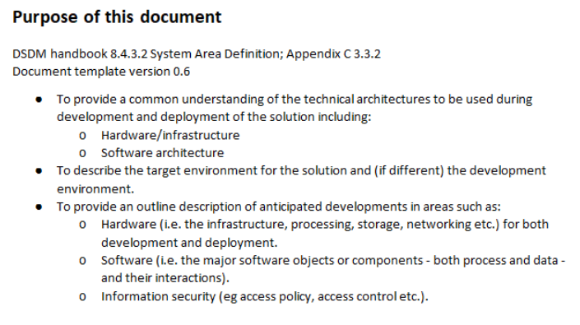
DSDM Products – Solution Architecture Definition
Overview
Provides a high-level design framework for the solution.
Covers both business and technical aspects of the solution.
Describes the solution to a sufficient level of detail, ensuring the scope is clear.
Ensures the framework is flexible and does not restrict evolutionary development.
Example of SAD product
Click here:
3.3.2 Foundations - SAD system (PROJECT_CODE).docx

Slide 15
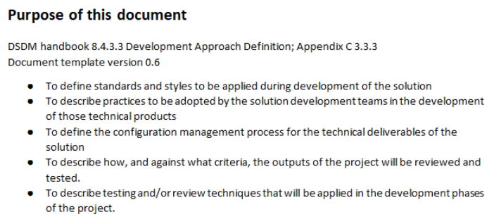
DSDM Products – Development Approach Definition
Overview
Provides a high-level definition of tools, techniques, customs, practices, and standards.
Guides the evolutionary development of the solution.
Defines how solution quality will be assured.
Includes a strategy for testing and review as a key part of the approach.
Ensures that development is structured, consistent, and aligned with project goals.
Example of DAD product
Click here:
3.3.3 Foundations - DAD development (PROJECT_CODE).docx

Slide 16
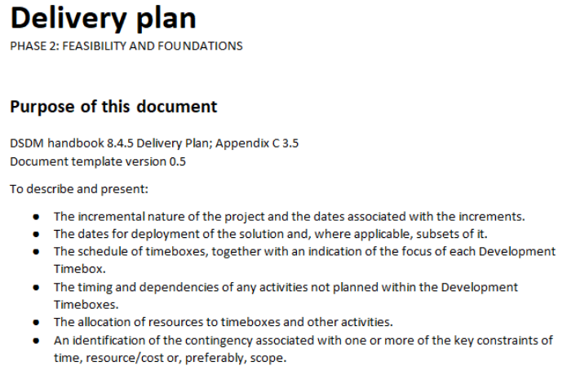
DSDM Products – Delivery Plan
Overview
Provides a high-level schedule of project increments.
Includes, at minimum, details of the first/imminent increment.
Breaks down increments into timeboxes that make up each increment.
Typically does not cover task-level detail.
May include task-level detail only when:
    Tasks are done by people outside the Solution Development Team, or
    Tasks occur before the Solution Development Team is formed.
Example of Delivery Plan product
Click here:
3.5 Foundations - Delivery plan (PROJECT_CODE).docx

Slide 17
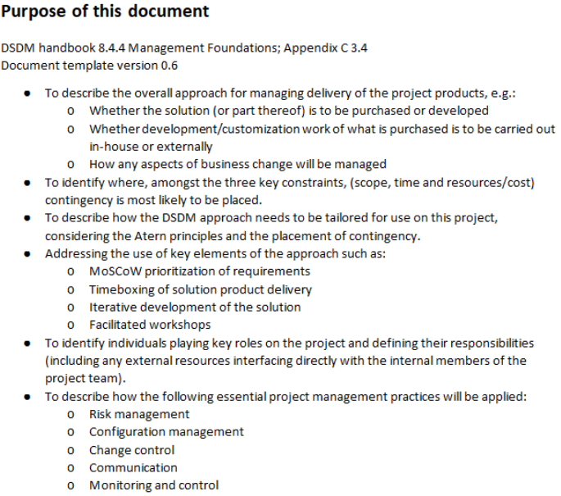
DSDM Products – Management Approach Definition
Overview
Defines the overall management approach for the project.
Describes how the project will be organized and planned.
Explains how stakeholders will be engaged throughout the project.
Outlines how progress will be demonstrated and, if needed, reported.
Created during Feasibility and baselined at the end of Foundations
Evolves only when:
Circumstances change, or
Review identifies improvements in the approach.
Example of MAD product
Click here:
3.4 Foundations - MAD management (PROJECT_CODE).docx

Slide 18
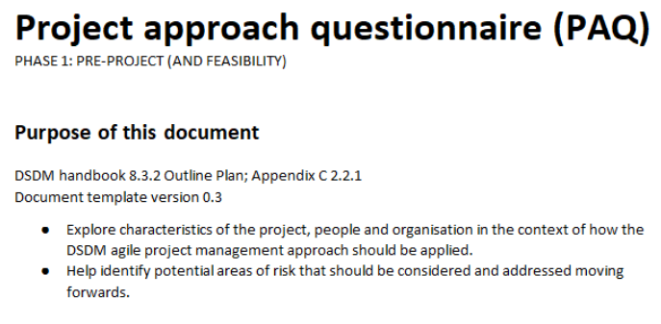
DSDM Products – Feasibility Assessment
Overview
Provides a snapshot of evolving business, solution, and management products.
Conducted at the end of the Feasibility phase.
Ensures products are mature enough to support decision-making.
Helps determine whether the project is likely to be feasible or not.
Can be expressed as:
A baselined collection of products, or
An executive summary covering key aspects.
Example of Feasibility Assessment product
Click here:
2.2.1 Feasibility - PAQ (PROJECT_CODE).docx

Slide 19
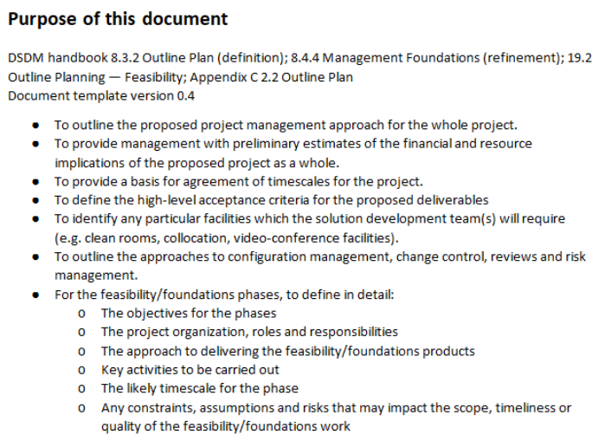
DSDM Products – Foundations Summary
Overview
Provides a snapshot of evolving business, solution, and management products.
Conducted at the end of the Foundations phase.
Ensures products are mature enough to support decision-making.
Helps determine if the project is likely to deliver the required return on investment (ROI).
Can be expressed as:
A baselined collection of products, or
An executive summary covering key aspects.
Example of Foundations Summary product
Click here:
2.2 Feasibility - Outline plan for foundations (PROJECT_CODE).docx

Slide 20
DSDM Products – Evolving Solution
Overview
Comprises all appropriate components of the ultimate solution.
Includes intermediate deliverables needed to explore requirements and build the solution.
At any given time, components may be:
Complete,
A baseline of a partial solution (Solution Increment),
Or A work in progress.
Overview
May include valuable items such as:
Models,
Prototypes,
Supporting materials,
Testing and review artefacts.
At the end of each Project Increment, the Solution Increment is:
Deployed into live use, and
Becomes the Deployed Solution.

Slide 21
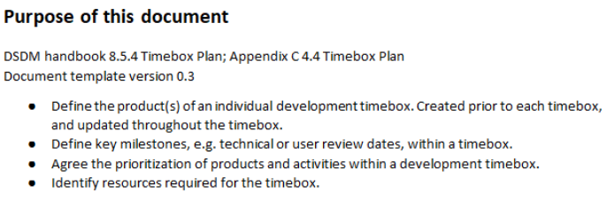
DSDM Products – Timebox Plan
Overview
Provides detailed depth for each Timebox identified in the Delivery Plan.
Defines the objectives and deliverables of the Timebox.
Specifies the activities and resources needed to achieve deliverables.
Created by the Solution Development Team.
Often represented on a Team Board as:
Work to do,
Work in progress,
Work done.
Updated frequently — at least daily during Stand-ups.
Example of Timebox Plan product
Click here:
4.4 EED - Timebox plan (PROJECT_CODE).docx

Slide 22
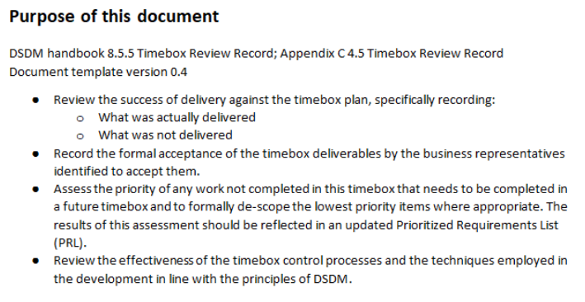
DSDM Products – Timebox Review Record
Overview
Captures feedback from each review held during a Timebox.
Describes what has been achieved up to that point.
Records feedback that may influence future plans.
In regulated environments, may serve as a formal, auditable record.
Includes review comments from Business Advisors and other roles.
Acts as a governance product when formalized.
Example of Timebox Review Record product
Click here:
4.5 EED - Sprint review record (sprint nn) (PROJECT_CODE).docx

Slide 23
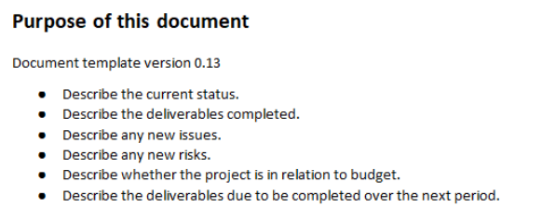
DSDM Products – Project Review Report
Overview
A single document updated incrementally at the end of each Project Increment.
Includes new sections relevant to each increment.
Purpose at the end of each Project Increment:
Capture feedback from solution reviews – confirm what has and hasn’t been delivered.
Capture learning points from retrospectives (processes, practices, roles, responsibilities).
Describe business benefits gained through proper use of the delivered solution.
At project closure:
A final retrospective is carried out, covering the entire project.
Informed by records from each Project Increment.
Example of Project Review Report product
Click here:
3.6.1 Foundations - Project status report template (PROJECT_CODE).docx

Slide 24
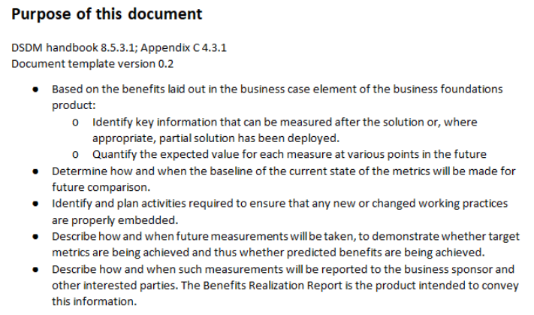
DSDM Products – Benefits Assessment
Overview
Describes how benefits have actually accrued after the solution is in live operation.
Conducted following a period of real use.
For projects with long-term benefits (as per the Business Case):
Multiple Benefits Assessments may be produced.
These are done on a periodic basis.
Aligned with the timeframe used to justify the investment.
Example of Benefit Assessment product
Click here:
4.3.1 EED - Benefits realisation plan (PROJECT_CODE).docx

Slide 25
DSDM Products – Summary
Products act as guidelines for communicating project information clearly and effectively.
They are not mandatory in all projects only used where they add value.
Formal documents are useful when governance, compliance, auditability or stakeholder alignment is needed (beyond just shared understanding).
The most important goal is ensuring stakeholders & participants understand what is needed and what will be delivered, and ensuring quality is assured.
Only create documents / products if they help achieve communication, alignment, clarity — avoid wasting time on unnecessary documentation.

Slide 26
Planning and Control
Introduction
Although DSDM (like all Agile) values responding to change over strictly following a plan, it emphasises high-level planning to shape and guide the project without micromanaging who does what and when.
Planning in DSDM begins with agreeing on a strategy (how the solution will evolve) and includes:
• Incremental delivery through project increments and timeboxes Agile Business Consortium
• Quality assurance integration, ensuring review and testing are built into development rather than tacked on later
Planning and Control
To support planning and control, DSDM defines:
• Three planning concepts: outcome-based planning; planning to sensible horizons; plan & re-plan using best estimates
• Six testing concepts, such as integrated testing, collaborative testing, repeatable testing, prioritised testing, independent testing, and test-driven approaches
• Four tracking & control concepts, including timeboxing with outcome measurement, transparency of process/progress, embracing change, and management by exception

Slide 27
Project Planning Concepts
Concept ​ | Definition / Purpose ​ | How it works in DSDM ​ | Benefits / Considerations ​
Outcome-based planning ​ | Focuses on delivering business value and outcomes rather than micromanaging tasks ​ | Project Manager and project roles plan at a high level for the outcomes needed; Solution Development Teams plan within each timebox for how to achieve those outcomes​. | Keeps planning aligned with business goals; enables empowerment and flexibility ​
Planning to sensible horizons at the right level of detail ​ | Use shorter planning horizons for near-term work and longer horizons at higher level ​ | Delivery Plan covers months ahead (project increment) with coarse detail; Timebox Plans cover only the next 1-4 weeks in greater detail.​ | Reduces wasted effort in planning unknowns too early; balance certainly and adaptability ​
Plan & re-plan based on best available estimates ​ | Accepts that estimates evolve and plans must adapt. ​ | Initial estimates are rough; as more is learned (especially during Foundations / early timeboxes), plans are refined and re-planned ​ | Allows adaption to reality, accommodates change, improves forecast accuracy over time​.
Notes:
As the project progresses and more is known about:
Requirements, and
The Evolving Solution,
predictions of delivery can be refined.
Accuracy of previous estimates is validated by actual development work.
Refinements help predict what will be delivered within:
The fixed timeframe of the current Project Increment, and
Potentially the whole project.
Estimate accuracy can be improved by following best practices:
Use more than one estimation technique.
Perform group estimation.

Slide 28
Testing Concepts
Concept ​ | Purpose / Essence ​ | Key Practices / Approach ​ | Benefits & Challenges ​
Testing integrated Throughout ​ | Embeds testing into very timebox rather than leaving it as a separate phase ​ | Plan a test strategy early; include test activity in same timebox as development; aim for the solution to be deployable at the of timebox where possible ​ | Finding defects early reduces cost & risk ; may not always be fully testable every timebox depending on complexity​
Collaborative Testing ​ | Involve all stakeholders in testing to accelerate test-fix cycles ​ | Business, technical, development, and testing roles collaborate in planning, execution, and review of tests​ | Improves shared understanding and quality; can require extra coordination and communication ​
Repeatable Testing ​ | Ensure that tests can be rerun reliably ​ | Every timebox tests new features and regression tests of earlier features; use automation where possible​ | Maintains quality baseline and prevents regressions; automation setup effort may be significant ​
Prioritised Testing ​ | Not all tests can run all the time- choose which are most critical ​ | Use risk, likelihood, impact criteria and MoSCow to decide which tests must/should/could be run classify defects similarity ​ | Helps focus efforts on high-risk areas; lower priority tests may be delayed and some defects tolerated​
Independent Testing ​ | A separate perspective ensures objectivity ​ | Someone other than the creator of a feature must test it; business and advisor roles may help as independent testers.​ | Helps reduce bias and catch misunderstandings; may require extra resource planning​
Test-Driven Development (TDD)​ | Shift testing to lead the development cycle​ | Define tests first, then write code to pass them; tests help clarify requirements​ | Improves code quality and clarity; may slow down initial development and requires discipline​

Slide 29
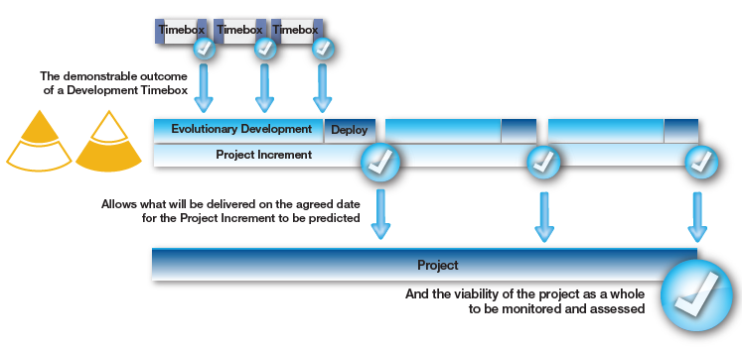
Tracking and Control Concepts
Timeboxing and Outcome-Based Measurement
Timeboxes provide a nested planning structure to support outcome-based measurement
Focus is on what has been delivered as part of a Solution Increment at the end of a Timebox.
Each Solution Increment is demonstrated and formally accepted by the Business Ambassador or Business Visionary.
This ensures the delivered outcome is fit for purpose and valid for measurement.
Comparing actual outcomes with planned outcomes provides a clear indicator of:
Whether the Project Increment is on track.
Whether the project as a whole is viable.
Discipline at the Timebox level gives control over:
Each Timebox,
Each Project Increment, and
The entire project.
Notes:
Diagram (Figure 9a) highlights:
Demonstrable outcome from each Development Timebox → builds confidence.
Evolutionary development and deployment → form a Project Increment.
Predicts what will be delivered on agreed dates.
Overall viability of the project is monitored and assessed at each level.

Slide 30
Tracking and Control Concepts
Transparency of Process and Progress
Transparency at Timebox level is achieved through:
Team Board
Daily Stand-up
These ensure visibility and control for the Solution Development Team.
Aspect ​ | Team Board​ | Daily Stand-up​
Purpose​ | Shows the detailed plan and ongoing activities​ | Provides team updates and short-term planning​
Visibility​ | Makes tasks and ownership visible to everyone​ | Makes progress and blockers visible
Focus​ | Who is doing what, effort required, and issues noted​ | What has been done, what will be done, and blockers​
Outcome​ | Helps track fulfillment of requirements in Solution Increment | Ensures collaborative problem-solving and proactive action
Frequency​ | Continuously visible | Happens daily

Slide 31
Tracking and Control Concepts
Responding to Change
In a dynamic business environment, change is:
Inevitable and should be welcomed as part of refining the solution.
Must be controlled to stay aligned with business needs, delivery timelines, and quality.
Aspect ​ | Project Level​ | Solution Development Team Level​
Responsibility​ | Business Visionary​ | Solution Development Team, with support from Business Ambassadors & Advisors
Type of Change​ | High-level requirements (breadth)​ | Detailed requirements (depth)
Control​ | Formal approval required​ | Managed at team’s discretion
Alignment | Ensures solution meets business vision | Ensures solution fits evolving business needs
Formality​ | More formal change control | Less formal, more flexible
Constraints | Approved only if necessary and aligned with business vision | Must remain within time, cost, and quality constraints
Outcome | Maintains overall project direction and scope | Adjusts detailed solution delivery without changing scope

Slide 32
Tracking and Control Concepts
Management by Exception
Management by exception:
Bridges the boundaries of empowerment.
Involves project-level roles only when needed.
Ensures focus on strategic decisions rather than routine work.
Aspect ​ | Team-Level Empowerment​ | Project-Level Escalation​
Scope of Decisions​ | Day-to-day management within a Timebox | Wider project-level impact decisions
Authority​ | Solution Development Team | Project-level roles (e.g., Business Visionary, Project Manager)
Allowed Actions​ | De-scope Could Have requirements; decide on detail of work | Step in when escalation is needed
Conditions | Work remains within tolerance; Must and Should Have can be achieved without risking quality | When Must/Should requirements cannot be met or quality would be compromised
Benefits​ | Rapid decision-making and progress; flexibility within the team | Ensures strategic alignment and protects project outcomes
Approach | Empowerment | Guidance and oversight

Slide 33
DSDM Planning & Control – Summary
Timeboxing & Outcome-based Measurement
Focus on delivered outcomes (Solution Increments).
Demonstrations & acceptance ensure progress is on track.
Transparency of Process & Progress
Team Board shows tasks, ownership, and issues.
Daily Stand-ups: progress, plans, blockers → visibility.
Responding to Change
Change welcomed but controlled.
Project Level: Business Visionary approves high-level changes.
Team Level: Handles detail-level changes within constraints.
Management by Exception
Teams empowered for daily decisions within tolerance.
Escalate only when Must/Should requirements or quality at risk.

Slide 34
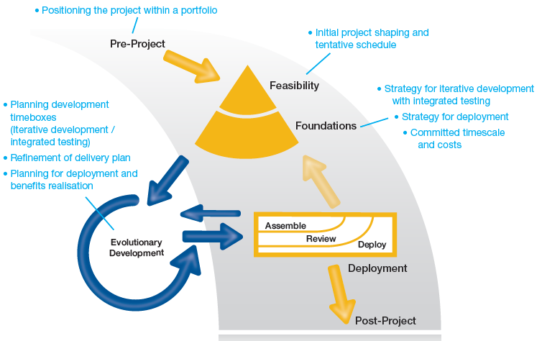
Planning Throughout the Lifecyle
Iterative development of plans
Pre-Project
Positioning project within a portfolio.
Initial project shaping and tentative schedule.
Feasibility
Assess viability of project.
Define initial strategy for iterative development with integrated testing.
Foundations
Strategy for deployment.
Committed timescale and costs.
Evolutionary Development
Iterative development with integrated testing.
Planning development timeboxes.
Refinement of delivery plan.
Deployment
Assemble → Review → Deploy solution increments.
Deliver solution into live use.
Post-Project
Realization of benefits.
Ongoing review of outcomes.
Notes:
Iterative Development of Plans
Pre-Project
Positioning project within a portfolio.
Initial project shaping and tentative schedule.
Feasibility
Assess viability of project.
Define initial strategy for iterative development with integrated testing.
Foundations
Strategy for deployment.
Committed timescale and costs.
Evolutionary Development
Iterative development with integrated testing.
Planning development timeboxes.
Refinement of delivery plan.
Deployment
Assemble → Review → Deploy solution increments.
Deliver solution into live use.
Post-Project
Realisation of benefits.
Ongoing review of outcomes.

Slide 35
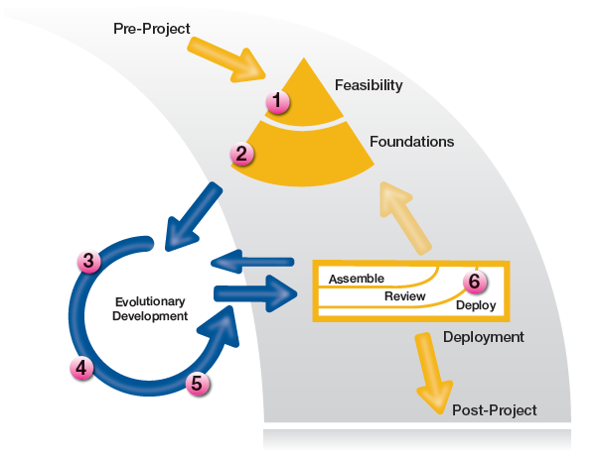
Planning and Quality
Quality control and assurance in the DSDM process
1. High-Level Risk Analysis (Feasibility)
Identify high-level risks (performance, security, resilience).
Establish how quality will be assured early.
2. Planning & High-Level Analysis (Foundations)
Refine vague requirements into high-level, clear requirements.
Encourage collaboration between Business, Solution Developers, and Testers.
Shared understanding ensures solution can meet business needs.
3. Detailed Analysis & Planning (Evolutionary Development)
Define detailed requirements and acceptance criteria.
Consider multiple perspectives before starting development.
Prepare for quality assurance activities.
4. Prepare & Run Tests
Tests designed collaboratively for each feature.
Test execution captures detailed, repeatable results.
Lightweight documentation supports transparency and sharing.
Notes:
Iterative Development of Plans
Pre-Project
Positioning project within a portfolio.
Initial project shaping and tentative schedule.
Feasibility
Assess viability of project.
Define initial strategy for iterative development with integrated testing.
Foundations
Strategy for deployment.
Committed timescale and costs.
Evolutionary Development
Iterative development with integrated testing.
Planning development timeboxes.
Refinement of delivery plan.
Deployment
Assemble → Review → Deploy solution increments.
Deliver solution into live use.
Post-Project
Realisation of benefits.
Ongoing review of outcomes.

Slide 36
Planning and Quality
Quality control and assurance in the DSDM process
5. Assess Quality & Impact
Identify defects early, take corrective actions.
Priorities defects blocking progress.
Manage residual defects by scheduling remediation or deferring to next Timebox.
6. Final End-to-End Testing & Assuring Implementation (Deployment)
Test complete solution end-to-end.
Validate non-functional requirements (e.g., performance, usability).
Confirm solution is fit for purpose before deployment.
Post-deployment: assure success, design rollback or backup strategies.
Notes:
Iterative Development of Plans
Pre-Project
Positioning project within a portfolio.
Initial project shaping and tentative schedule.
Feasibility
Assess viability of project.
Define initial strategy for iterative development with integrated testing.
Foundations
Strategy for deployment.
Committed timescale and costs.
Evolutionary Development
Iterative development with integrated testing.
Planning development timeboxes.
Refinement of delivery plan.
Deployment
Assemble → Review → Deploy solution increments.
Deliver solution into live use.
Post-Project
Realisation of benefits.
Ongoing review of outcomes.

Slide 37
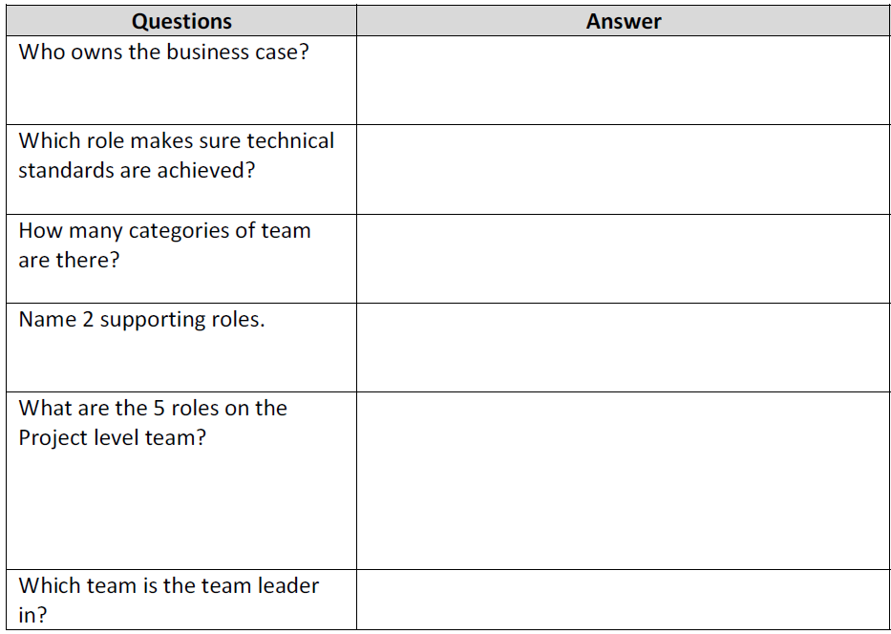
Agile Roles & Responsibilities Review Questions

Slide 38
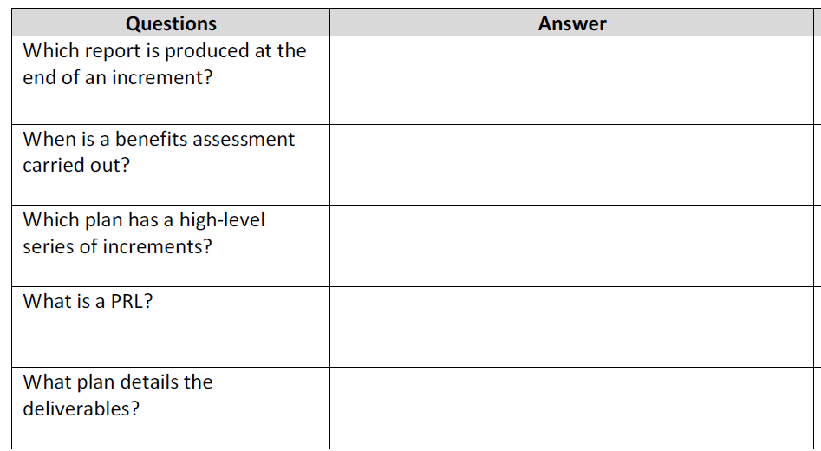
Agile Products Review Questions

Slide 39







THANK YOU
In the Name of God for Mankind
www.utm.my

